Slide 1
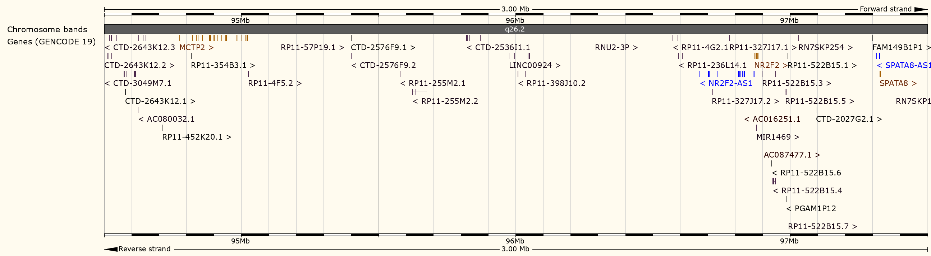
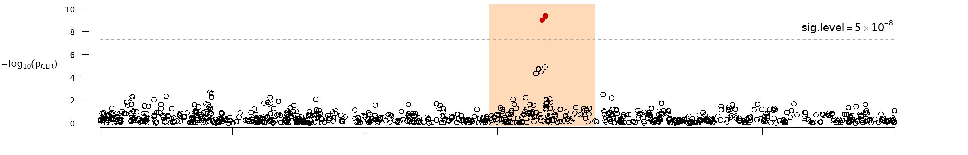
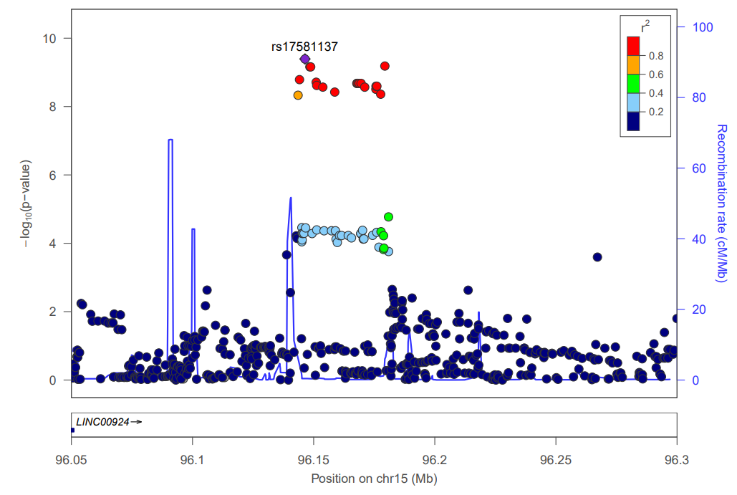
Chromosome 15
Genotyped + Imputed SNPs

Slide 2
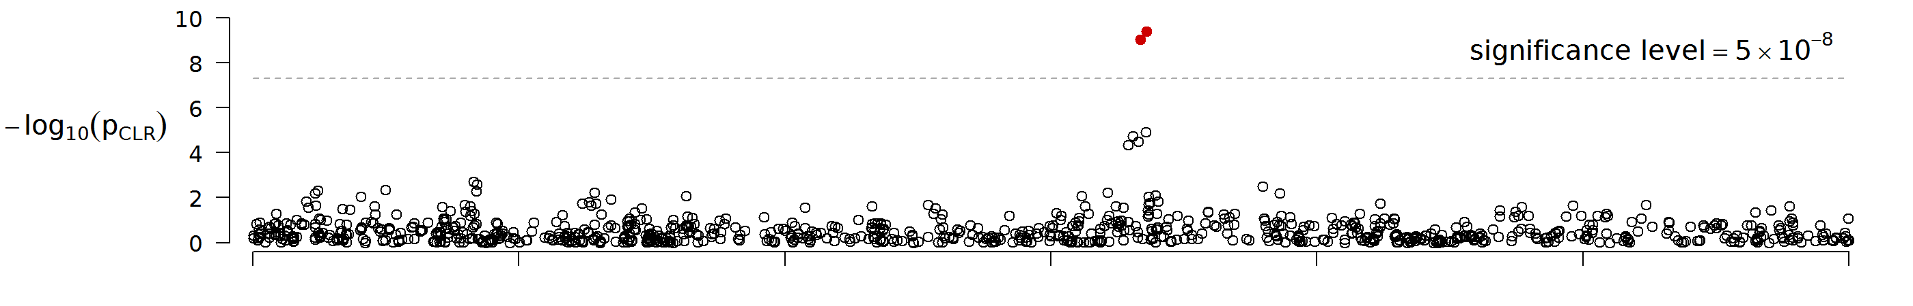
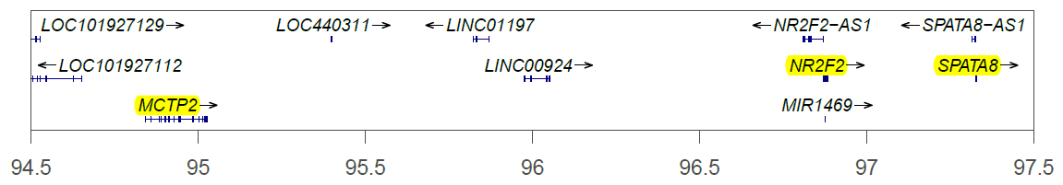
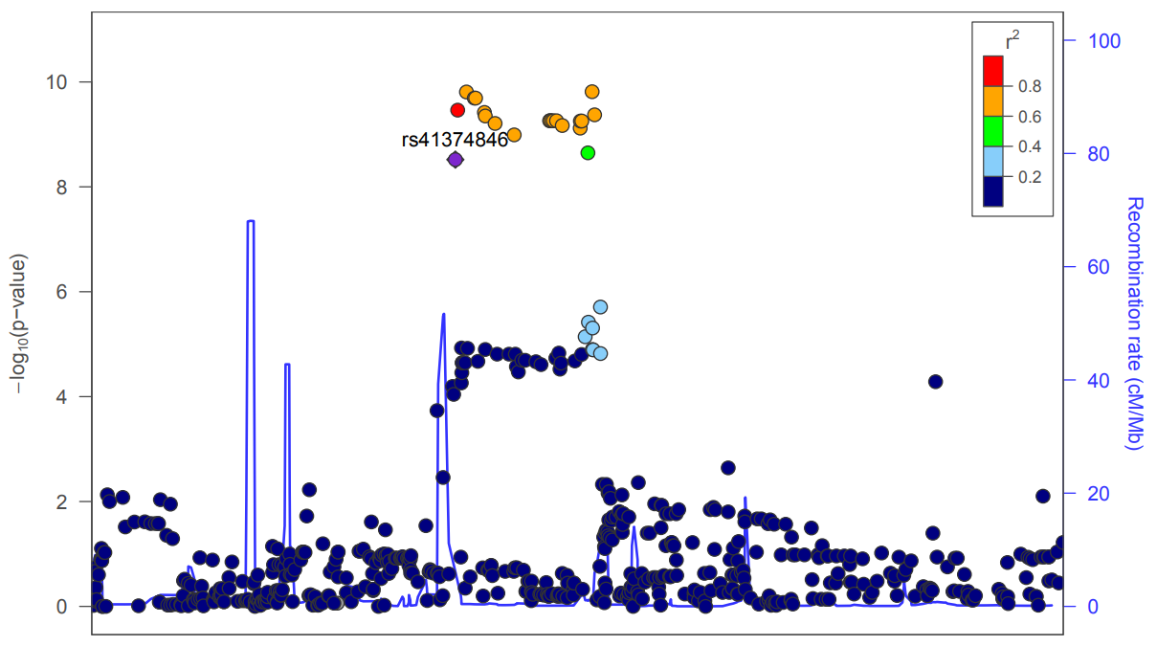
A
Chromosome 15
B
Position on chr15 (Mb)
Genotyped + Imputed SNPs
C
Genotyped + Imputed SNPs

